Slide 1
Random (De)Selection
Saket Saurabh
Institute of Mathematical Sciences + University of Bergen
(CALDAM 2024, 16th February 2024)

Slide 2
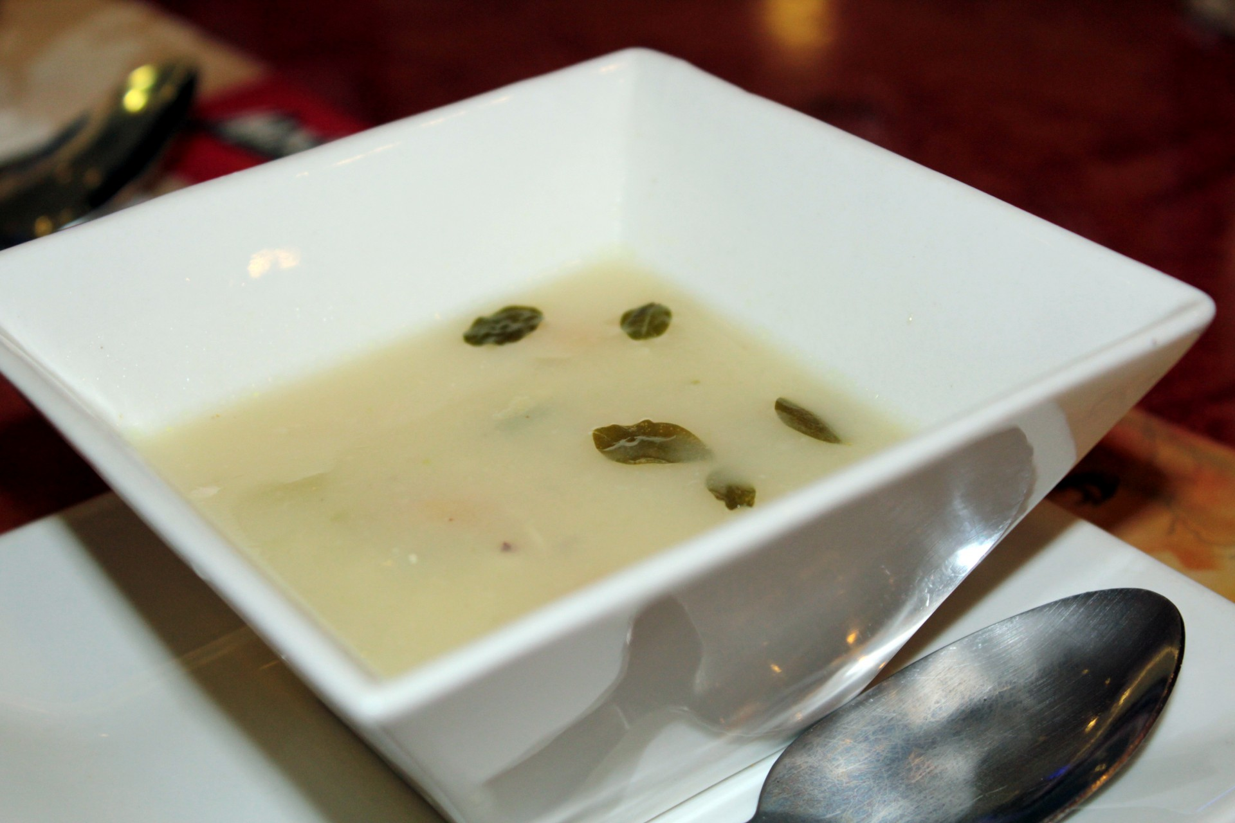
What is Random Deselection?
Water versus Dal (lentils)

Slide 3
Random DeSelection
Global Mincut

Slide 4
Global Mincut
Input: Graph G=(V,E)
Output: A smallest-size set of edges E’ such that G=(V,E-E’) is not connected.

Slide 5
Example
F
A
B
E
G
C
D

Slide 6
Example
F
A
B
E
G
C
D
E’ = BE

Slide 7
First Go
For every pair of nodes s,t find the min-cut M_{s,t}
Choose the pair {s,t} with the smallest M_{s,t} .
Time= O(n² T(min-cut))

Slide 8
Time for Min-Cut
Ford-Fulkerson: O(|E| flow)
In our case: max flow ≤ n
so: O(n² |E|n) = O(n² n³)
This can be improved.

Slide 9
Improvement
We don’t need all pairs.
Why?
Every node is in one side of a cut.
Therefore: Fix node s. Try all other n-1 options as node t.
Time: O($n^{4}$)

Slide 10
Karger’s Randomized Algorithm
Repeat Until 2 nodes left:
1. choose edge at random
2. “contract” edge
When only 2 node left:
Take all edges between them as the min-cut.
Time: O(|E|)=O(n²)

Slide 11
Meaning of “contraction”
Make edge ab with its two adjacent nodes a,b into a single node ab.
All edges of a and b will now be edges from ab (creating a multigraph).

Slide 12
Example
F
A
B
E
G
C
D

Slide 13
Example
F
A
contract
B
E
G
C
D

Slide 14
Example
F
A
contract
B
E
G
C
D
FG
A
B
E
C
D

Slide 15
Example
F
A
contract
B
E
G
C
D
FG
A
B
E
C
D
contract

Slide 16
Example
F
A
contract
B
E
G
C
D
FGD
FG
A
A
B
E
B
E
C
D
C
contract

Slide 17
Is output min-cut?
Not necessarily.
Is it a cut?
yes.

Slide 18
Is output min-cut?
Not necessarily.
Is it a cut?
yes.
Could there be an edge
between these sides that
was deleted?

Slide 19
Is output min-cut?
Not necessarily.
Is it a cut?
yes.
No. The only deleted
edges were within
the contractions.

Slide 20
Is output min-cut?
Not necessarily.
Is it a cut?
yes.
cut C={e1,…,ek}
No. The only deleted
edges were within
the contractions.

Slide 21
When is C a min-cut?
When none of the edges in
C={e1,…,ek}
are chosen to be contracted.
What is the probability of that happening?

Slide 22
Probability calculation
Note: We can assume that degree of every node in graph throughout contraction process ≥ k

Slide 23
Probability calculation
Note: We can assume that degree of every node in graph throughout contraction process ≥ k
Otherwise:
Cut node and get cut of size < k.

Slide 24
Analysis of Contraction Algorithm
Which one?
Claim: Contraction Algorithm returns a min cut with probability at least 1/n².
Proof: Consider a specific global min-cut (A*, B*) of G. Let F* be the edges in the cut and k = |F*|
In the first step, an edge in F* is contracted with probability k / |E|.
Every node has degree ≥ k,
Otherwise (A*, B*) would not be a min-cut
⇒|E| ≥½kn.
Hence: an edge in F* is contracted with prob. ≤ 2/n.

Slide 25
…Analysis of Contraction Algorithm
After j iterations: there are n’ = n-j (super)nodes
Suppose no edge in F* has been contracted:
The mincut in G’=(V’,E’) is still of size k
Therefore |E’| ≥ ½k∙n’
Thus the algorithm contracts an edge in F* with probability ≤2/n’
Let E_{j} be the event: “an edge in F* has not been contracted in iteration j”
E₁ ∩ E₂ ∩ … ∩ E_{n-2}
The good case

Slide 26
Finally!
≥
n(n-1)
n²

Slide 27
Probability calculation
Probability that one of the C edges is chosen at first stage:

Slide 28
Probability calculation
Probability that one of the C edges is chosen at first stage:
Probability that one of the C edges is chosen after stage i ≤:

Slide 29
Probability calculation
Probability that one of the C edges is chosen at first stage:
Probability that one of the C edges is chosen after stage i ≤:
Probability of not choosing an edge of C at stage i ≥:

Slide 30
Probability calculation
Note: The algorithm has n-2 stages (at that point 2 nodes are left). Probability of not choosing an edge from C at any stage ≥
=

Slide 31
Probability calculation
What do we have?

Slide 32
Probability calculation
What do we have?
Telescope cancellations:
=

Slide 33
Conclusion
Run the algorithm O(n²) times and expect to get C with constant probability.
Total time:
No better than Ford-Fulkerson!
Can we do better? – Story for some other day!

Slide 34
Water versus Dal
What played the role of Water?
What played the role of Dal?

Slide 35
Random DeSelection
k-Cut

Slide 36
k-Cut
Input: Graph G=(V,E)
Output: A smallest-size set of edges E’ such that G=(V,E-E’) has at least k connected components.
k=2 is the Global Mincut problem.

Slide 37
Karger’s Randomized Algorithm
Repeat Until 2k nodes left:
1. choose edge at random
2. “contract” edge
When only 2k node left:
Return a random k-partition of what remains as k cut.
Time: O(|E|)=O(n²)

Slide 38
Conclusion
Finds the mincut with probability at least $2^{−2k}/\left({n \atop 2k}\right)$ $≈{O_{k}(n}^{−2\left(k−1\right)})$
Proof: when r vertices remain, probability to contract an edge in OPT is
$$\frac{OPT}{\text{\#}\text{edges}}$$
$$≤ \frac{\left(k−1\right)⋅average of smallest k−1 degrees}{(r⋅average of all r degrees)/2}$$
$$≤ \frac{2(k−1)}{r}$$
Pr[OPT survives contraction] $≈ \prod{(1 −\frac{2\left(k−1\right)}{r}})≈exp⁡(−2\left(k−1\right)H_{n})$ $≈n^{−2(k−1)}$

Slide 39
Water versus Dal
What played the role of Water?
What played the role of Dal?

Slide 40
Random DeSelection in Exponential World
(or Randomized Contraction)
(IKPRS ITCS 2024)

Slide 41
Amenable Problems
Cut Problems: Edge Multiway Cut, k-Cut, Edge Multicut, Edge Bisection, Edge Odd Cycle Transversal
Graph Problems: Edge Deletion Problems to a graph class
$ℱ$ that are closed under contractions.
Examples: Interval Graphs, Chordal Graphs, Cluster Graphs
$$ℱ$$

Slide 42
Edge Multicut
Input: Graph G=(V,E), and terminal pairs, $\left\{si,\text{t}\text{i}\right\}$, i $∈\left\{1,2,…, q\right\}.$
Output: A smallest-size set of edges E’ such that in G=(V,E-E’), no s_{i} and t_{i} are in the same connected components.

Slide 43
Interval/Chordal/Cluster Edge Deletion
Input: Graph G=(V,E)
Output: A smallest-size set of edges E’ such that G=(V,E-E’) is an interval/chordal/cluster graphs.
Cluster Graphs: Disjoint Union of Cliques

Slide 44
History: What do we know?
NP-complete problems
Most do not have polynomial time constant factor approximation, (unless, P$≠$NP or UGC)
Trivial 2^{m} poly(n) exact algorithm.
Try all possible subsets of edges
Actually, we can do better!

Slide 45
$∂\left(C\right)$ denotes the set of edges leaving the component C.
$$C$$
Components are either chordal/interval/clique. Solution edges are seen across.

Slide 46
Chordal Edge Deletion via DP
For $A⊆V(G)$, Chordal[A]= the size of a smallest-size set of edges E’ such that G[A]-E’ is a chordal graph.
Chordal[A] $= min{ |∂\left(A^{′}\right)|+CED[A\backslash A^{′}]}$
$${ A}^{′}⊆A,$$
$$G\left[A^{′}\right]is chordal$$
Running Time = $\sum_{k≥0}{\left({n \atop k}\right)\text{2}\text{k} }$ = 3^{n}
Using ``subset convolution trick” we can fill this DP in time 2^{n}

Slide 47
Can we do better than 2^{n} for cut problems or edge deletion problems?
No known exact algorithm whose running time is of the form ${(2−δ)}^{n}.n^{𝓞(1)}$ for most of these problems.
*One exception, k-Cut has such algorithm.
^{(ICALP 2023, LSS)}

Slide 48
Next Question
Can we come up with good approximation algorithms in time ${(2−δ)}^{n}.n^{𝒪(1)}$for these problems?

Slide 49
Chordal Edge Deletion
Input: Graph G=(V,E)
Output: A smallest-size set of edges E’ such that G=(V,E-E’) is a chordal graphs

Slide 50
Water versus Dal
Who can play the role of Water?
Non solution edges
Who can play the role of Dal?
Solution edges

Slide 51
Global Min-Cut and k-Cut
Too much Water that until graph became of size 2 or k, dal was not very visible!
So thick dal at the very end!
What does thick dal means?
What can we do if we get thick dal in soon?
Thickness of Dal depends on individuals.

Slide 52
Chordal Edge Deletion
Input: Graph G=(V,E)
Output: A smallest-size set of edges E’ such that G=(V,E-E’) is a chordal graphs
$β$- $Thick Dal$: If m is at most $β$ times |E’|=OPT (Water is at most$β$ times Dal)
$m ≤β$ OPT
If thick dal, just eat and stop complaining!

Slide 53
Chordal Edge Deletion
Input: Graph G=(V,E)
Output: A smallest-size set of edges E’ such that G=(V,E-E’) is a chordal graphs
$β$- $Thick Dal$: If m is at most $β$ times |E’|=OPT
$m ≤β$ OPT
Return all the edges in G as solution!

Slide 54
Chordal Edge Deletion
Return all the edges in G as solution!
Approximation Ratio:
$$\frac{m}{OPT}≤\frac{β OPT}{OPT}≤β$$
So if the input is thick we get factor$β$
approximation

Slide 55
Chordal Edge Deletion via Thick Dal Principle
Input (G,$β$, OPT)
Repeat Until $m ≤β$ OPT edges left:
1. choose edge at random
2. “contract” edge
When $m ≤β$ OPT :
Return all the edges in G as solution.
Time: O(|E|)=O(n²)

Slide 56
Algorithm in Action
Graph with $\left|V\right|=n, \left|E\right|=m$
C $=$ optimal solution
$\left|C\right|=$OPT
$$⋯$$
$$1$$
$$2$$
$$q$$

Slide 57
Before Contraction
C $=$ optimal solution
$\left|C\right|=$OPT
$$⋯$$
$$u$$
$$v$$
$$1$$
$$2$$
$$q$$

Slide 58
After Contraction
C $=$ optimal solution
$\left|C\right|=$OPT
$$⋯$$
$$uv$$
$$1$$
$$2$$
$$q$$

Slide 59
Is output $β$approximate solution?
Not necessarily.
Is it a solution? – not necessary
Not necessary a chordal!

Slide 60
After Contraction
C $=$ optimal solution
$\left|C\right|=$OPT
$$⋯$$
$$uv$$
$$1$$
$$2$$
$$q$$

Slide 61
Chordal Edge Deletion via Thick Dal Principle
Input (G, $α$, OPT)
Repeat Until $m ≤β$ OPT edges left:
1. choose edge at random
2. “contract” edge
When $m ≤β$ OPT and each ``contracted vertex” is chordal in G
Return all the edges in G, say S, as solution.
Else, return Fail.

Slide 62
Is non-fail output, $β$ approximate solution?
Output is S. Not necessarily.
Is it a solution?
Yes
C={e1,…,ec} be edges in an optimum solution.

Slide 63
Algorithm in Action
Graph with $\left|V\right|=n, \left|E\right|=m$
C $=$ optimal solution
$\left|C\right|=$OPT
$$⋯$$
$$1$$
$$2$$
$$q$$

Slide 64
When is S$β$ approximate solution?
When none of the edges in
C={e1,…,ec}
are chosen to be contracted.
What is the probability of that happening?

Slide 65
Probability calculation
If we pick an edge $e∈E$ uniformly at random
The probability of the event that
$e∉C$ $=\frac{m −OPT }{m}$ $=1−\frac{OPT}{m}$
As, $m>β$ OPT, $\frac{OPT}{m}<\frac{1}{β}$
$$\left(1−\frac{OPT}{m}\right)>\left(1−\frac{1}{β}\right) = \frac{β−1}{β}$$

Slide 66
Contraction as Vertex Reducers
How many times will contraction happen?
A contraction reduces the number of vertices by $1$. So at most n times. Assume this happens $γn$ times.
What is the success probability?
Succeeded with probability:
$${\left(\frac{β−1}{β}\right)}^{γn}≥{\left(\frac{β−1}{β}\right)}^{n}$$

Slide 67
Conclusion
Run the algorithm ${q=\left(\frac{β}{β−1}\right)}^{n}$ times, return the smallest among them and expect to get S with constant probability.
Total time: $q.n^{𝒪(1)}$
Not all q iterations fail
1 -
$$1/q$$
q
(1 - )
$≥$ 1 – 1/e
$≥$ 1/2
☺

Slide 68
Towards (1+$ε$) Approximation
One contraction operation reduces the number of vertices by $1$
If we succeed in this contraction step for roughly $γn$consecutive steps, then we would have reduced the number of vertices to
$(1 −γ)n$

Slide 69
First Attempt
Knowledge: The problem has an exact exponential algorithm of running time $2^{n}.n^{𝒪(1)}$
After $γn$ consecutive contractions, we use the exact algorithm on the residual instance in time
$2^{(1−γ)n} n^{𝒪(1)}={(2−δ)}^{n}.n^{𝒪(1)}$
success with probability ${\left(\frac{β−1}{β}\right)}^{γn}$

Slide 70
First Attempt Succeeds Almost
By repeating this sufficiently (i.e.,${\left(\frac{β}{β−1}\right)}^{γn}$times), we end up with a running time that is bounded by
${ 2}^{(1−γ)n} n^{𝒪(1)} .{\left(\frac{β}{β−1}\right)}^{γn}$
And with constant success probability.

Slide 71
Why First Attempt Fails?
Clearly, $2^{(1−γ)n} n^{𝒪(1)} .{\left(\frac{β}{β−1}\right)}^{γn}$ beats $2^{n} n^{𝒪(1)}$ for some $β>1, γ<1$
Problem is that $γ$ could be 0, or small. That is no contraction step is applied.
Example in the input $m≤β$OPT

Slide 72
Zooming into the bad Case
$m≤β$OPT
Size of OPT is comparable to the total number of edges in the original graph.

Slide 73
Greedy Vertex Reducers
x
$X⊆V$ of smallest degree, take all the edges incident on them into the solution
solve the problem exactly on $G∖X$ and get a solution $S’$
Combine $S’$and edges incident to $X$ and output it.
Edges incident on X is at most
$ε$OPT. Good Strategy if |X|$≥δn$
G\X

Slide 74
Approximation Ratio
Let $S=S’⋃$ set of edges incident to $X$
$\left|S\right|=|S’|+\text{E}\text{dges} \text{incident} \text{to} X$
$≤$ OPT$\left(G∖X\right)+ε$ OPT$(G)$
$≤$ OPT$\left(G\right)+$ $ε$ OPT$\left(G\right)$
$=(1+ε)$OPT$(G)$

Slide 75
Why such X exists?
Vertices sorted by degree, smaller to bigger.
First q vertices such that $\sum_{v∈X}{deg⁡(v)}$ $≥$ $ε$OPT(G) [OPT]
Next q vertices.
Lower bound on q?
Rq $≥$ n
=> q $≥\frac{nε}{2β+ε}$
How many blocks?
(R-1)$×$ $ε$OPT$≤2β \text{OPT}$
=> R $≤\frac{2β}{ε}$+1

Slide 76
Chordal Edge Deletion via Thick Dal Principle
Input (G, $α$, OPT)
Repeat Until $m ≤β$ OPT edges left:
1. choose edge at random
2. “contract” edge
When $m ≤β$ OPT and each ``contracted vertex” is chordal in G
``Greedy Vertex Reducers and exact algorithm”
Else, return Fail.

Slide 77
Hand Waives
Guessing of OPT?
Running Time Combination to get the best constants.
(1+$ε$) approximation in 2^{f(}$ε$^{)n} , f($ε$)<1.

Slide 78
Random DeSelection
Feedback Vertex Set in Tournaments
(LMMPPS, SODA 2020, TALG 2021)

Slide 79
Feedback Vertex Set … in Tournaments
In:
Tournament G, integer k
Question:
Does there exist a vertex set S such that:
|S| $≤$ k
Of smallest size
G – S has no cycles
A
B
E
Feedback Vertex Set
C
D

Slide 80
Feedback Vertex Set … in Tournaments
In:
Tournament G, integer k
Question:
Does there exist a vertex set S such that:
|S| $≤$ k
Of smallest size
G – S has no cycles
A
B
E
Feedback Vertex Set
C
D

Slide 81
Known about FVST
NP-complete
Next slide: simple 3-Approximation
Cai, Deng and Zhang, 2000: 2.5-approximation
Mnich, Vassilevska Williams
and Vegh, 2016:
2.33-approximation
No 1.9999 assuming UGC
Clever LP stuff!
LMMPPS, SODA 2020:
Will see soon!
2-approximation

Slide 82
Some facts about Tournaments
A tourament G contains a cycle
$$↔$$
An acyclic tourament
G contains a triangle
has a unique topological ordering

Slide 83
3-Approximation
S := $∅$
While G – S contains a triangle uvw
Add {u,v,w} to S
Return S
Each iteration increases S by 3
Each iteration decreases OPT by at least 1
S $≤$ 3 OPT

Slide 84
2-Approximation, Specs
Always runs in polynomial time
Randomized
Always outputs a feedback vertex set S
Algorithm can fail:
S is not necessarily a 2-approximate solution!
Algorithm does not fail too much:
For every input, S is a 2-approximate
solution with probability $≥$ ½

Slide 85
The algorithm
Case 1: OPT $≥$ n/2
Every feedback vertex set S is 2-approximate!
Case 2: OPT $<$ n/2
OPT
Pick a random vertex p
G - OPT
P[success] $≥$ 1/6
middle 1/3
Success = p is here

Slide 86
Declare p undeletable
N⁻(p)
N⁺(p)
v
u
p
$≤$ 5n/6
$≤$ 5n/6
Case a:
exists an edge uv from N⁺(p) to N⁻(p)
At least one of {u,v} must be in OPT!
Add both {u,v} to S and delete them
S increases by 2,
OPT decreases by at least 1

Slide 87
No back edge
N⁻(p)
N⁺(p)
p
$≤$ 5n/6
$≤$ 5n/6
Case b:
no edge from N⁺(p) to N⁻(p)
SMALL
G[N⁻(p)] and G[N⁺(p)] are independent sub-instances!
Solve recursively!

Slide 88
The algorithm - almost
ALG(G)
If G is acyclic return $∅$
Pick random vertex p out of all vertices with
indegree and outdegree $≥$ n/6
S:= $∅$
While exists edge uv from N⁺(p) - S to N⁻(p) - S
Add {u,v} to S
Return S $∪$ ALG(G[N⁺(p)] – S) $∪$ ALG(G[N⁻(p)] – S)
Always runs in polynomial time:
T(n) $≤$ 2T(5n/6) + O(n²)
Always outputs a feedback vertex set S
How likely is S to be 2-approximate?

Slide 89
Success probability
Success in this call
if
1/6
$$⋅$$
1/2
$$⋅$$
1/2
Successfully
selected
pivot p
The call on
N⁺(p) succeeds
The call on
N⁻(p) succeeds
☹
= 1/24
$<$ 1/2

Slide 90
The algorithm
ALG(G)
If G is acyclic return $∅$
For i = 1 to 24
Pick random vertex p_{i} out of all vertices with
indegree and outdegree $≥$ n/6
S_{i} := $∅$
While exists edge uv from N⁺(p_{i}) - S to N⁻(p_{i}) - S
Add {u,v} to S_{i}
S_{i} := S_{i} $∪$ ALG(G[N⁺(p_{i})] – S) $∪$ ALG(G[N⁻(p_{i})] – S)
Return smallest S_{i}
Always runs in polynomial time:
T(n) $≤$ 48T(5n/6) + O(n²)
Always outputs a feedback vertex set S
How likely is S to be 2-approximate?

Slide 91
Success probability
Success in this call
if
Not all 24 iterations fail
1 -
$$1/{24}$$
24
(1 - )
$≥$ 1 – 1/e
$≥$ 1/2
☺

Slide 92
Summary - FVST
Polynomial time algorithm
Always outputs a Feedback Vertex Set
Output solution is 2-approximate with probability $≥$ ½

Slide 93
Similar Problem
Cluster Vertex Deletion
In:
Graph G
Task:
Find minimum size vertex set S
s.t. G – S is a disjoint union of cliques
Naive:
3-approximation
You, Wang, Cao, 2015:
2.5-approximation
Fiorini, Joret, Schaudt, 2015:
2.33-approximation
No 1.999 assuming UGC
Aprile, Drescher, Fiorini, Hyunh, 2022:
2-approximaiton

Slide 94
Open Problems
Look at other problems of this nature.
A nontrivial approximation for any graph class that is characterized by exclusion of finite induced subgraphs

Slide 95
Picked random vertex
So :
Declared it is in solution
Random Selection
Pick random vertex/edge
And:
Declare it is NOT in solution
Random Deselection

Slide 96
Moral
Sometimes
silly looking algorithms
miraculously work

Slide 97
Summary
If you don’t know what to do
Do something random

Slide 98
THANKS!

Slide 99
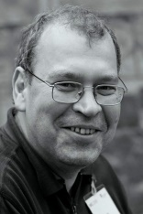
Exponential Time Algorithms
Naive Feedback Vertex Set: 2^{n}
Can we do better?
Razgon, 2006: 1.89^{n}
FGPR, 2008: 1.75^{n}
Xiao and Nagamochi, 2013: 1.7356
Fomin, Todinca and Villanger, 2015: 1.7347^{n}
This talk: 1.63^{n}

Slide 100
Feedback Vertex Set
If k/n < 1/2.7
Run the 2.7^{k} time algorithm
Put random vertex in solution
If k/n $≥$ 1/2.7
(Delete and decrease k)
How to analyze?
... analyze …
$$O({[2−\frac{1}{2.7}]}^{n})$$
=
O(1.63^{n})

Slide 101
Algorithm, re-stated
n vertices, guess solution size k.
Pick integer t $≤$ k cleverly.
Pick random vertex set S of size t, put it in solution.
Remove S from G.
Look for solution of size k - t in G – S in time 2.7^{k – t}n^{O(1)}

Slide 102
Analysis
Running time: 2.7^{k – t}n^{O(1)}
No false positives
What is prob. of finding solution if there is one?
$$\frac{\left({k \atop t}\right)}{\left({n \atop t}\right)}$$
#ways to pick a subset of size
t from the solution (of size k)
#ways to pick a subset of size
t from the universe (of size n)

Slide 103
Analysis, part II
For constant success probability repeat $\frac{\left({n \atop t}\right)}{\left({k \atop t}\right)}$ times
$$\frac{\left({n \atop t}\right)}{\left({k \atop t}\right)}{2.7}^{k−t}n^{O(1)}$$
Total time:
$$\max_{k≤n}{}$$
$$\min_{t≤k}{}$$
$$≤O({(2−1/{2.7})}^{n+o(n)})$$
$$≤O({1.63}^{n})$$

Slide 104
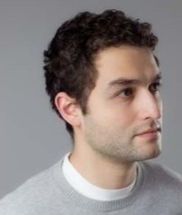
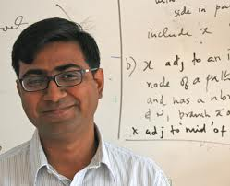
Subset Problems
Nothing special about Feedback Vertex Set.
Works for every subset problem!
FGLS [2016, STOC, JACM]:
For subset problems
$$O({[2−\frac{1}{c}]}^{n})$$
c^{k}n^{O(1)}
→

Slide 105
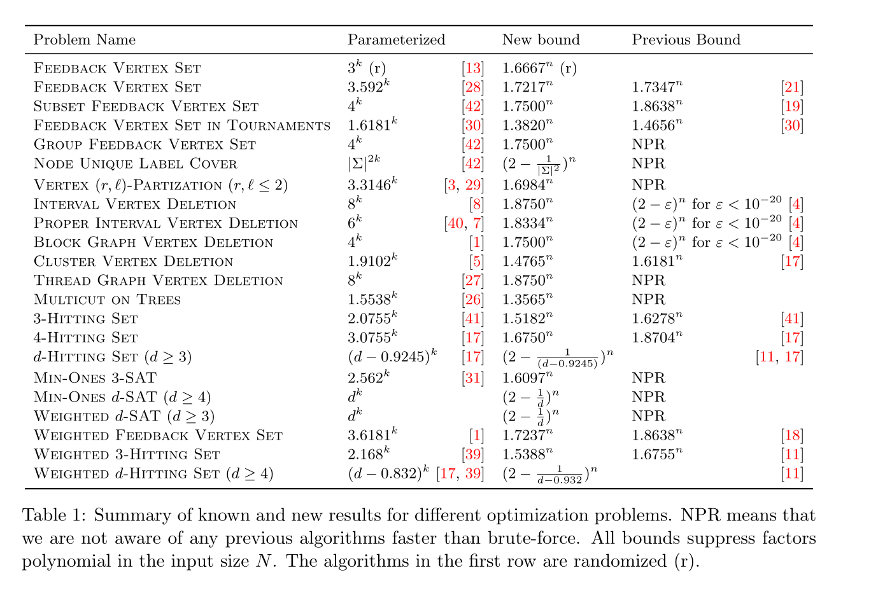
Corollaries

Slide 106
Our Approximation Algorithm
A randomized c-approximation for X
S = Ø
While S is not a solution.
Clean G - S
Pick a random edge uv in G – S
Pick a random x $∈$ {u, v}
S = S $∪$ {x}
Automata-theory based
graph cleaning
Same algorithm is a c^{k}k(n+m) time FPT algorithm!
Main observation: P[x is in some optimal solution to G – S] $≥$ 1/c

Slide 107
Open Problems
Constant, or even polylog approximation for Planarization?
c^{k}n^{O(1)} time algorithm for Planarization?
Constant factor approximation of
vertex-weighted deletion to
minor free classes excluding at least one planar graph?

Slide 108
Random Selection

Slide 109
Feedback Vertex Set
In:
Graph G, integer k
Question:
Does there exist a vertex set S such that:
|S| $≤$ k
Of smallest size
G – S has no cycles
A
Feedback Vertex Set
B
E
NP-complete
C
D

Slide 110
Parameterized Algorithms
What if k is small?
Naive: O(n^{k+1})
Polynomial for tiny super-constant
k = log log log log n?
Try all subsets of size k
$$↔$$
Polynomial if k is constant
f(k)n^{c}
FPT

Slide 111
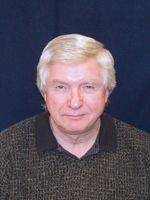
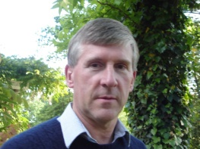
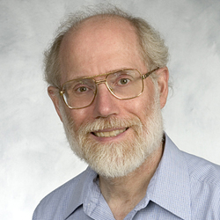
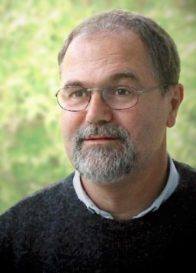
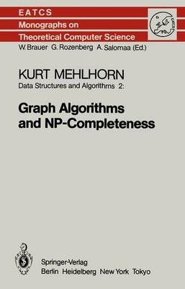
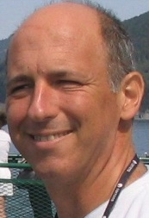
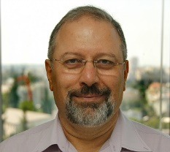
Is Feedback Vertex Set FPT?
Late 80’s: Yes, by Graph Minors magic!
David Johnson: “For any instance that one could fit into
the known universe, one would easily
prefer n⁷⁰ to even constant time, if that
constant had to be one of Robertson
and Seymour’s.”
Late 80’s: Reasonable FPT algorithm?
Early 80’s (Mehlhorn): YES!
Next: 4^{k}k(n+m) time randomized algorithm by Becker, Bar-Yehuda and Geiger
(2000)

Slide 112
Main Lemma
Let G be a graph,
Let S be a feedback vertex set of G,
Let uv $∈$ E(G) be a random edge of G.
Then, with probability at least ½,
at least one of {u,v} is in S

Slide 113
Algorithm Assuming Main Lemma
S = $∅$
Has one endpoint in OPT
with probability $≥$ ½
While S is not a Feedback Vertex Set
Pick random edge uv in G - S
Is in OPT
with probability $≥$ ½
Pick random vertex x in {u,v}
Add x to S
|OPT| decreases by 1 with probability $≥$ ¼
Output S
Algorithm runs in time O(|S|(n+m))
Success prob:
$$1/{4^{k}}$$
Notes:
Always outputs Feedback Vertex Set S Succeeds in all k first iterations → |S| $≤$ k

Slide 114
Fake News!
Main Lemma is wrong:
S
Probability a random edge is incident to S is $2/n$
Bad example has lots of degree 2 vertices….

Slide 115
Getting rid of low degree vertices
Vertices of degree 0 and 1 are never part of any cycle, just remove them (for free)
A vertex of degree 2 never has to be in an optimal solution – can pick neighbors instead.
Cleaned graph
Has minimum degree 3
→ Shortcut!

Slide 116
The real Main Lemma
Let G be a graph of mimimum degree $≥$ 3
Let S be a feedback vertex set of G
Let uv $∈$ E(G) be a random edge of G.
Then with probability at least ½,
at least one of {u,v} is in S

Slide 117
Algorithm Assuming Main Lemma
S = $∅$
Has one endpoint in OPT
with probability $≥$ ½
While S is not a Feedback Vertex Set
Clean G – S of degree 0, 1 and 2 vertices
Pick random edge uv in G - S
Pick random vertex x in {u,v}
Is in OPT
with probability $≥$ ½
Add x to S
Output S
|OPT| decreases by 1 with probability $≥$ ¼
Success prob:
$$1/{4^{k}}$$
Notes:
Always outputs Feedback Vertex Set S Succeeds in all k first iterations → |S| $≤$ k

Slide 118
Proof of Main Lemma
S
GOOD edges
BAD
edges
Sufficient to show:
each component of G – S has more good than bad edges

Slide 119
Good vs Bad
Bad component (tree!) has b bad edges → b+1 vertices
In the tree, the vertices have degree 1,2 or $≥$ 3
Each vertex of degree 1 in tree has $≥2$ good edges
Each vertex of degree 2 in tree has $≥1$ good edge
Each vertex of degree $≥$3 … may have 0 good edges...
… but #degree $≥$ 3 is
less than #degree 1!
GOOD $>$ b+1 > BAD

Slide 120
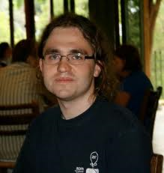
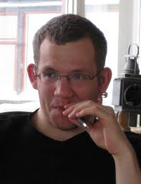
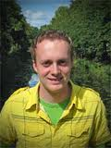
Feedback Vertex Set - Conclusions
Simple randomized 4^{k}(n+m) time algorithm.
KP 2014: 3.592^{k}n^{O(1)} deterministic
Cut and Count (Randomized): 3^{k}n^{O(1)}
LN 2019: 2.7^{k}n^{O(1)}
(Randomized)

Slide 121
Approximation Algorithms
The Becker et al. algorithm
is also a
polynomial time 4-approximation
In expectation,
|S| $≤$ 4|OPT|
Analysis:
In each iteration we pay 1 euro (add one vertex to solution)
With probability ¼, OPT decreases by 1.
In expectation, need 4OPT iterations before OPT reaches 0
Notes:
Remember to explain the algorithm again!!

Slide 122
Vertex Deletion Problems
Vertex Cover
Feedback Vertex Set
Deletion to Independent Set
Deletion to Acyclic Graphs (Forests)
Planarization
Deletion to Planar Graphs
Series-Parallel Deletion
Deletion to Series-Parallel graphs
Interval Deletion
Deletion to Interval Graphs

Slide 123
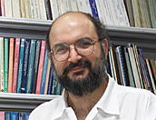
Vertex Deletion Problems
John
Murchie
Lewis
Which vertex deletion
problems are NP-hard?
LY [1980]
«Almost all» of them
Which have constant factor approximation algorithms?
Theorem [FLMS, 2012, FOCS] «Many» of them

Slide 124
«Many» Vertex Deletion Problems Have Constant Factor Approximation Algorithms
Theorem [FLMS, 2012]
Example: Acyclic Graphs (forests)
Vertex deletion problems to classes closed under:
vertex deletion
edge deletion
minor closed
edge contraction
and excluding at least one planar graph
have a constant factor approximation algorithm.
Notes:
Dont forget example of a minor closed graph class (say acyclic graphs).

Slide 125
Random (De)Selection
Saket Saurabh
Institute of Mathematical Sciences + University of Bergen
(CALDAM 2024, 16th February 2024)

Slide 126
Coping with Hardness
No algorithm solves
all instances
optimally
in polynomial time
Parameterized Algorithms
Approximation Algorithms
Exponential Time (APX)
Algorithms

Slide 127
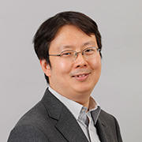
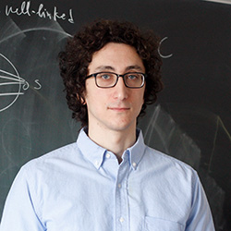
Vertex Cover
Feedback Vertex Set
Deletion to Independent Set
Deletion to Acyclic Graphs (Forests)
[KS, 2017]:
poly(log n)-approximation for Planarization in quasipolynomial time.
Series-Parallel Deletion
Deletion to Series-Parallel graphs
Planarization
Deletion to Planar Graphs
Exclude Planar
Minor Closed
Interval Deletion
Deletion to Interval Graphs

